Slide 1
CALENDAR SCHEDULER APPLICATION

Slide 2
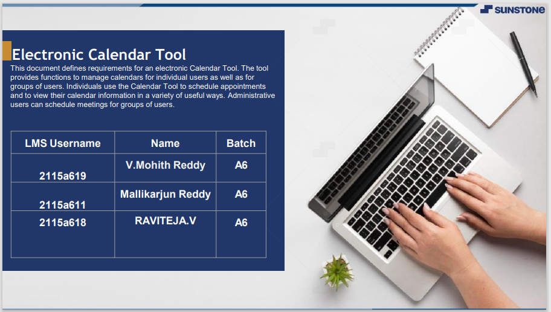


ELECTRONIC COMMERCE
The intended audience of the SRS is primarily our customer Synergy Soft Inc, and all parties interested on the design and development of the SDMS.
LMS Username | Name | Batch
2115a440 | PUCHALAPALLI HARI DINESH REDDY | A4
2115a442 | RANGESH D | A4
2115a453 | SRIPURAM MOHAN REDDY | A4
2115a450 | SHAIK MOHAMMAD WASEEM | A4

Slide 3
INTRODUCTION
This document defines and describes the functional and non-functional requirements for the SDMS. It will be use as the basis for the design phase and as a reference for development and validation stages.
The intended audience of the SRS is primarily our customer Synergy Soft Inc, and all parties interested on the design and development of the SDMS.

Slide 4
The overall objective of the Synergy Distributed Meeting Scheduler (SDMS) is to develop a customizable, decentralized system that allows individuals or organizations to easily, efficiently, and precisely schedule meetings in accordance with practical limitations of virtual and real-world meetings. The SDMS will be a web based application designed to support the meeting scheduling needs of an organization. It will not require a client based application; instead it will be accessible and conform to standard HTML Web Application practices. The SDMS will interface with and utilize third party resources to facilitate all of the users’ meeting scheduling needs (e.g. database services, email communication, etc.).

Slide 5
The Overall Description
Product Perspective
The SDMS is aimed towards organizations with frequent meeting scheduling, organization, and administration needs. The SDMS will facilitate meeting management for both traditional and distributed meeting styles to meet the needs of modern work environments.
The SDMS will be a browser based web service application. The SDMS shall be accessible by any popular web browsers such as Internet Explorer, Firefox, Opera and Safari.

Slide 6
The Overall Description
Product Perspective
The SDMS shall utilize third-party applications to facilitate its features. A database system will store and organize all existing meeting data. The SDMS will interface with the default mail client and/or specified mail server to facilitate inter-user communication. Rooms and equipment will be managed by a third-party property management system. The SDMS will interface with the property management system to schedule equipment availability.

Slide 7
Specific Requirements
External Interface Requirements
Functional Requirements
Performance Requirements
Design Constraints
Software System Attributes

Slide 8
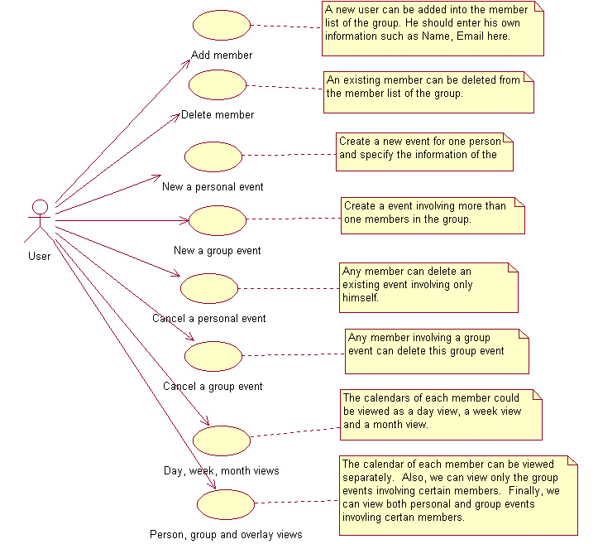
Modeling Requirements
Use Case Diagram

Slide 9
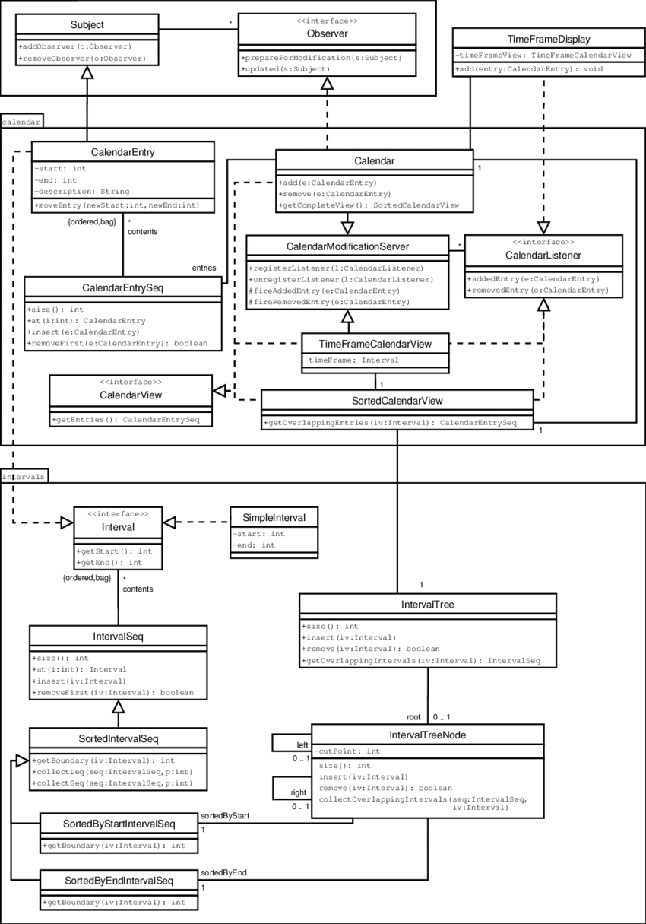
Modeling Requirements
Class Diagram

Slide 10
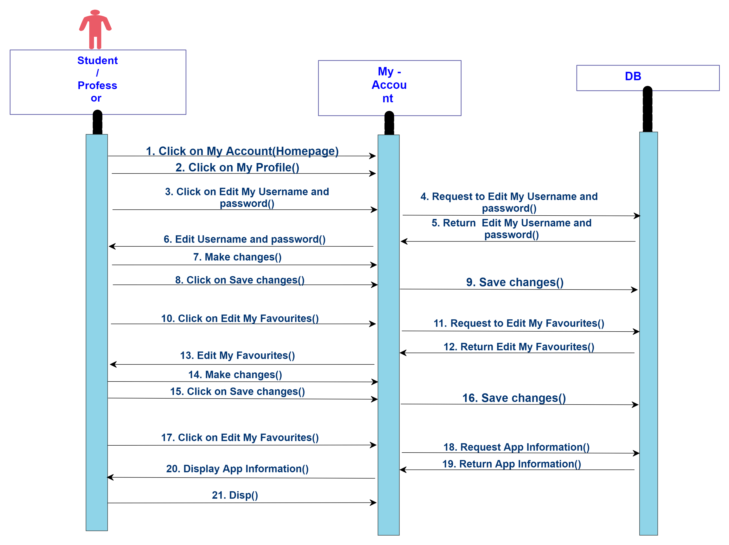
Modeling Requirements
Sequence Diagram

Slide 11
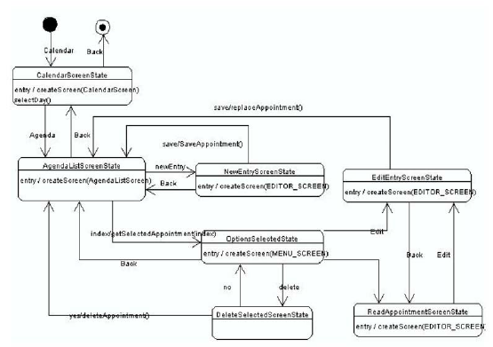
Modeling Requirements
State Diagram

Slide 12
GITHUB LINK
https://github.com/mohithredde/calender

Slide 13


